Slide 1
Software development
Dale Smallwood

Slide 2
Basics To Input and Output
C# provides its active users with a library of standard functions to use on a application. An example of this is using the computer keyboard to enter information.
To perform out put and input operations text C# uses streams.
This is the continuous flow of data from an output or input object. An output object is normally the display monitor and the Input monitor is normally the keyboard.

Slide 3
Standard Output
By default, the text output of the C++ program goes to the display monitor, and the stream object defined for this purpose is expensive. The cost object is used together with the insertion operator (< <).
cout << "Here is some text"; // outputs some text cout << 120; // outputs a number
The insertion operator can be used more than once in a statement to send different date types to the cout stream at the same time.

Slide 4
Standard Output Continued
cout << "Here is a number: " << 247;​
Note that successive cout statements do not appear on separate lines unless we ourselves include a new line escape character (\n) at the point where a new line is required. The following code fragment shows the use of the new-line escape sequence:​
cout << "This is line one.\n";​ cout << "This is line two.\nThis is line three";​
This produces the following output:​
This is line one.​ This is line two.​ This is line three.​
​
​
​
​

Slide 5
Standard Input
The standard input device in C# is the keyboard by default, and the stream object defined for this purpose is cin. The cin object is used together with the extraction operator (> > >).
The cin object can only process the keyboard input after the ENTER key is pressed.
Although cin is useful, the input is restricted to strings that do not contain white space. If we need to insert a string containing spaces or other white space characters, we can use the getline function.

Slide 6
Assignment
When changing a data value stored in a variable, an operation called assignment is used. As a result, the value is copied into a memory location, causing what was there before to be overwritten
During the execution program, different values can often be assigned to a variable at different times. Assignments are then overwritten from the current value with a new one.

Slide 7
Selection (If... Then...)
To evaluate whether an expression is true or not we use the If....Then statement. This is how it is used:
If ConditionToCheck Then Statement
A condition (ConditionToCheck) is examined in the program. This can be a combination or a simple expression. The program will check the statement to see if the ConditionToCheck evaluates to true. By following the keyword Then, any number of statements can be executed. The If . . . Then the statement can be written on one line if only one statement is to be executed.

Slide 8
Selection (If... Then...) Continued
Each statement should appear on a separate line if several statements are to be executed. It should look like this: If ConditionToCheck Then Statement 1 Statement 2 ........... Statement n End If
End if is used to terminate.

Slide 9
Selection (If... Then.... else)
This statement construct gives two alternative courses of action. If the specified condition is true, then the first alternative is chosen. If not, then the second alternative is chosen. It should look like this: If ConditionToCheck Then Statement1 Else Statement 2 End If This construct is similar to If . . . Then . . . Else, except a number of choices are offered. This is how it should look: If Condition1 Then Statement1 ElseIf Condition2 Then Statement2 ElseIf Condition Then Statement End If.

Slide 10
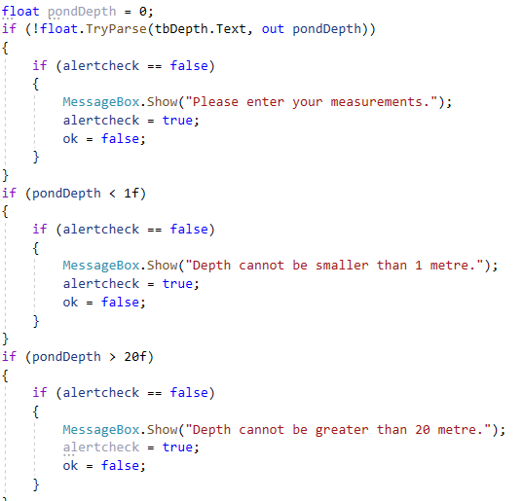
Selection (If... Then.... else) Continued
This statement shows if a number is less than 1 it will not progress the function, but when it is more than 1 then it will progress to the next page

Slide 11
Repetition (for, do, while)
A Do While Loop is a control flow statement used in most computer programming languages and executes a block of code. At least once, and then repeatedly executes a block, or not, depending on the Boolean condition at the end of the block.
The Do While Construction is a process symbol and a condition. First, the code inside the block is executed, and then the condition is evaluated. If the condition is true, the code inside the block will be executed again. This means that the code must always be executed first, and then the expression or test condition must be evaluated. If this is true, the code will run the loop body again.

Slide 12
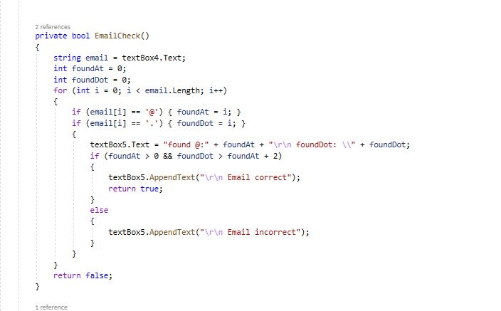
Example of a for loop
The line of code “for (int = 0; I <email.length; i++)
Checks the length of the input as it must be more than 0 letters

Slide 13
Repetition (for, do, while) Continued
This process is repeated if the expression is true. If the expression is false, the loop will terminate, and the control will be transferred to the statement following the Do While loop. In other words, while a while loop sets the truth of a statement as a pre-condition for the execution of the code, a Do While loop provides for the ongoing execution of the action, subject to the failure of the condition, of which the falsity (i.e. the truth of the negation of the condition) is set as a post-condition.
It is possible, and in some cases desirable, for the condition to always evaluate to true, to create an infinite loop. When such a loop is intentionally created, there is usually another control structure (such as a break statement) that allows the loop to be terminated.

Slide 14
MATHS equations:
Arithmetic in C# is similar to every other programming language , in particular C++, C, and Java.
This is how addition works: int a = 3 + 4;
This is how subtraction works: int b = 7 - 2;
When using multiplication an asterisk character is used ('*') as follows: int c = 4 * 3;
When using division the forward slash character is used ('/') las follows: int d = 21 / 7; Any of the standard numerical types such as double, float, int, short can be used.
Multiple operations can be combined into one, or a previously created variable in a statement: int f = 3 * b - 4;

Slide 15
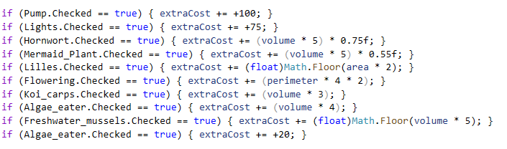
Math’s Continued
Here is a demonstration of a math's equation in C#

Slide 16
Variables
A variable is stored information that can be used throughout a program. Each attribute must be marked with a unique name or code. A string composed of one or more letters, digits or underscore characters is a valid identifier. Symbols and spaces cannot be used. When using variable names, you must begin with a letter or underscore character if not this can cause an error.
C is resilient to this case. That means the vector terms example, Example and EXAMPLE apply to three variables. The attribute might not have the same name as one of the C keywords. Keywords are reserved identifiers that have a special meaning in C. They can't be used as identifiers for your program.

Slide 17
Variable scope
Before a variable can be used in a C program it must be inputted. Depending on where the variable is placed within the program will determine the scope of the variable. A variable can have either a global or local scope.
A global variable is one that is declared outside of all functions (usually at the start of source code), and can be accessed from anywhere in the current source code file. A local variable is declared in a function or code block body and its scope is limited to the block it is declared in.
A variable defined in a function can only be reached within that feature through program code, and has automatic storage length. It ensures that when the role is required space is reserved, and de allocated when the feature is no longer needed.

Slide 18
Variable scope continued
It is possible to obtain static storage length by putting the keyword static in front of the vector declaration so that space is allocated when the program starts execution and stays allocated until the program is terminated..
Access to variables outside the source code file in which they are defined can be allowed by putting the external keyword in front of the specified variable. This enables accessing a variable specified in one source code file from code in another.

Slide 19
Variable scope
It is possible to access a global variable from anywhere in the system. Only within the body of the method in which it is defined will access a local variable. Therefore, the value of the product of the equation cannot be derived from the square function. Likewise, it is not possible to access the localInt variable value from outside the square function
For example, using
scanf("%d", &localInt);
instead of
scanf("%d", &globalInt);
would cause a compilation error, because the variable localInt is only visible within the square() function.

Slide 20
Data types
Variables of different types will occupy different amounts of memory. Computer memory is allocated to variables in blocks of one or more bytes, depending on the data type. A single byte, for example, can store one number chacter, a with an unsigned value ranging from 0 to 255, or with a signed value ranging from -128 to +127. Two or more bytes are required to store larger values and floating-point numbers.

Slide 21





Common C Data Types:
Type​ | Size (bytes)​ | Value range​
unsigned char​ | 1​ | 0 - 255​
char​ | 1​ | -128 - 127​
unsigned int​ | 2​ | 0 - 65,535​
short int​ | 2​ | -32,768 - 32,767​
int​ | 2​ | -32,768 - 32,767​
unsigned long​ | 4​ | 0 - 4,294,967,295​
long​ | 4​ | -2,147,483,648 - 2,147,483,647​
float​ | 4​ | 1.17549435 * 10-38 - 3.40282347 * 1038​
double​ | 8​ | 2.2250738585072014 * 10-308 - 1.7976931348623157 * 10308​
long double​ | 10​ | 3.4 * 10-4932 - 1.1 * 104932​

Slide 22
PROCEDURES, Event Driven
This is a programming paradigm in which events such as a user action such as a mouse click, a key press or a message from an operating system or another program determine the flow of program execution. The event-driven program is designed to detect accidents as they emerge and use an effective event-handling protocol to cope with them. The aim is to expand the form of interrupt-driven programming used in early command line environments such as DOS and embedded systems (where the code is run as a firmware).
Event based applications can be written in any programming language, although some languages (e.g. Visual Basic) are explicitly designed to facilitate programming guided by events and provide an Integrated Development Environment (IDE) that partly automates code creation and offers a robust set of built-in artifacts and controls, each capable of reacting to a variety of appliances. Quick both object-oriented and visual languages embrace programming that is guided by events. Types of these are the Visual Basic, Visual C++ and Java languages.

Slide 23
The event queue
In an event-driven system, a number of events may occur within a relatively short period of time. The scheduler, and the event handlers, may not be able to deal with all the events that occur right away. The best solution to this is to place uncontrolled events, in the event queue, until they can be dealt with. New events are added to the end of the queue when they arrive, and will be dealt with by the scheduler until they reach the front of the queue.
There may also be a priority scheme in operation in which certain types of events take place first over others. These events may be quickly tracked through the scheduler by moving them ahead in the queue, or there may be a separate queue for priority events.

Slide 24
The event queue continued
The purpose of the queue guarantees that all events will be dealt with at some point and in some form of order.
The length of the queue and the time taken to process events will likely depend on factors such as the speed of the processor, the amount of RAM installed and the number of other applications running at the same time. Most of the time, the queue will be empty. The scheduler will also be waiting for the next event.

Slide 25
How Event Driven Programming Works
A scheduler which receives a stream of events and forwards each event to the appropriate event handler is the main part of an event-driven application. The scheduler must remain active until it encounters an incident that allows the program to be discontinued (e.g. “Start Program”). Under certain conditions, the scheduler can experience an occurrence for which it is difficult to appoint the correct event handler. The scheduler may either disregard it, or make an exception (sometimes referred to as "throwing" an exception), depending on the nature of the case.
Typical events are usually defined in an event-driven programming environment using the entity ID influenced by the occurrence (e.g. the name of the action button for the form) and the event ID (e.g., "left-click"). Additional information may be transferred to the incident controller, such as the mouse pointer x and y coordinates at the time the event happened, or the Shift key status (if the case is a key-press).

Slide 26
More On How Event Driven Programming Works
Events are often actions performed by the user during program execution, but may also be messages generated by an operating system or other application, or interruptions generated by a device or hardware of the system.If the user clicks on the mouse button or hits the Enter key, this will generate the event. If a transfer of the file is done, an alert is. An event is created if a hardware or software error occurs. Things are managed by a main case-handler (usually called a dispatcher or scheduler) who works in the background constantly and waits for an event to happen. When an event occurs, the scheduler needs to determine the type of event and assign the correct event handler to manage it. The details the scheduler transmits to the event handler will vary but will contain sufficient information to allow the event handler to take any necessary action.

Slide 27
More On How Event Driven Programming Works
Activity handlers can be seen as small blocks of procedural code handling a very specific event. Normally we generate a visual answer to alert or guide the consumer, and often change the device's state. The device state contains both the details used by the program (e.g. the data contained in the database field) and the user interface status itself (e.g. the item being displayed on the computer or the text box context colour.
An event handler may even activate another event which triggers a call to a second event handler. Likewise, an event handler will trigger the discarding of any queued activities. The pseudo-code procedure below illustrates how a (very simple) scheduler might operate. It consists of a central loop which runs continuously until there is a certain terminating state. When an event occurs, the scheduler must determine the type of event and pick the appropriate event handler (or cope with the incident if there is no suitable event handler).

Slide 28
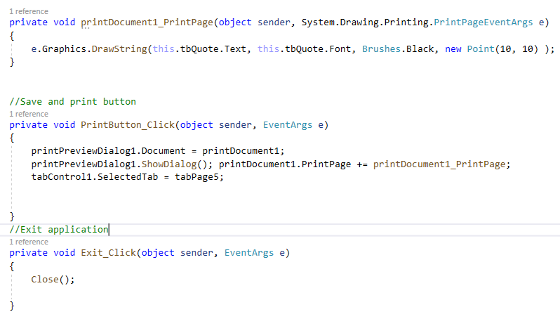
More On How Event Driven Programming Works
This line of code shows when a button is clicked it will open a print preview.

Slide 29
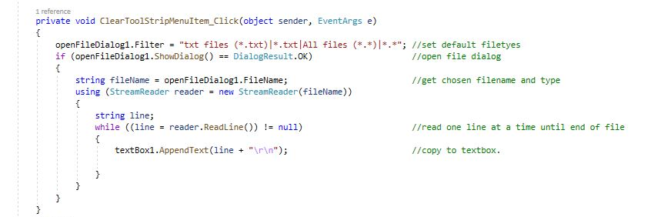
While loop example

